Slide 1
Breast Cancer Classification and Prognostic Risk Stratification Using Genomic and Clinical Features
23521583 - Pham Tran Xuan Tien
23521555 - Huynh Dien Thuc
23521625 - Bui Thi Thanh Trang
23521603 - Le Ngo Thanh Toan
GVHD: Vo Nguyen Le Duy

Slide 2
Team Task Assignment
Team Member | Task | Complete
Le Ngo Thanh Toan | Demo, Slide, Presentation | 25%
Huynh Dien Thuc | Data Preparation, Pre-Processing | 25%
Bui Thi Thanh Trang | EDA, Training Model | 25%
Pham Tran Xuan Tien | EDA, Slide, Report | 25%

Slide 3
Table of Content
Introduction & Problem Statement
Data Preparation
Exploratory Data Analysis
Data Preprocessing
Modeling & Results
Demo

Slide 4
Table of Content
Introduction & Problem Statement
Data Preparation
Exploratory Data Analysis
Data Preprocessing
Modeling & Results
Demo

Slide 5
Introduction & Problem Statement

Slide 6
Introduction
Breast cancer is one of the most common and deadly cancers worldwide.
High-throughput RNA sequencing (RNA-Seq) enables large-scale measurement of gene expression levels.
By analyzing gene expression profiles, we can distinguish tumor from normal tissue samples.

Slide 7
Introduction
Breast cancer is one of the most common and deadly cancers worldwide.

Slide 8
Introduction
Breast cancer is one of the most common and deadly cancers worldwide.
In 2022, there were an estimated 2.3 million women diagnosed with breast cancer and 670 000 deaths globally. Breast cancer occurs in every country of the world in women at any age after puberty but with increasing rates in later life.

Slide 9
Introduction
Breast cancer is one of the most common and deadly cancers worldwide.
In 2022, there were an estimated 2.3 million women diagnosed with breast cancer and 670 000 deaths globally. Breast cancer occurs in every country of the world in women at any age after puberty but with increasing rates in later life.

Slide 10
Introduction
Breast cancer is one of the most common and deadly cancers worldwide.
In 2022, there were an estimated 2.3 million women diagnosed with breast cancer and 670 000 deaths globally. Breast cancer occurs in every country of the world in women at any age after puberty but with increasing rates in later life.

Slide 11
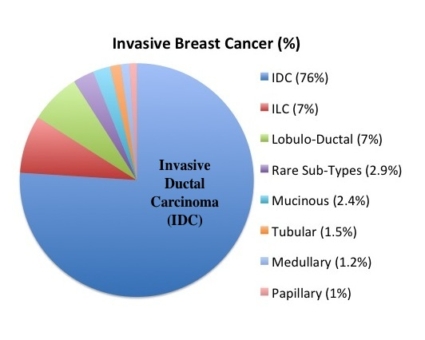
Introduction
The most common types of breast cancer are
invasive ductal carcinoma
invasive lobular carcinoma
…

Slide 12
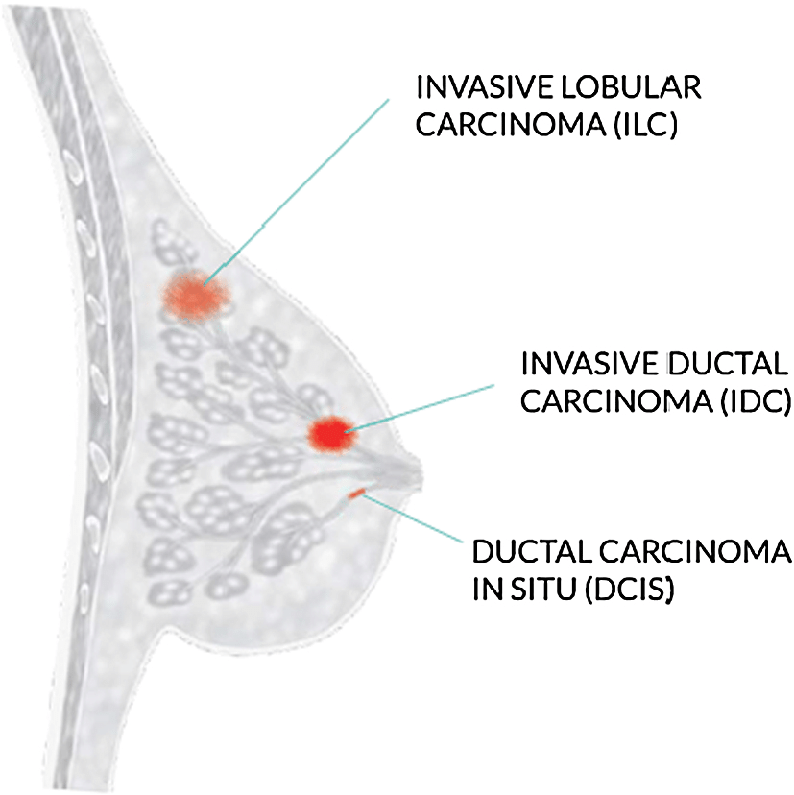
Introduction
The most common types of breast cancer are
invasive ductal carcinoma
invasive lobular carcinoma
…

Slide 13
Introduction
Timely and accurate detection of tumor tissue is therefore a critical clinical need.

Slide 14
Introduction
Modern sequencing technologies — in particular RNA-Seq — allow us to measure the expression level of every gene in a sample, producing a high-dimensional molecular profile that reflects the tumor’s biology.

Slide 15
Introduction
When a tissue becomes cancerous, many genes change their expression pattern; these changes create reproducible signatures that can distinguish tumor from normal tissue.

Slide 16
Introduction
Objective: Build and evaluate supervised models that
Task 1: predict whether a sample is tumor or normal from its gene expression vector.
Task 2: predict what the disease type from its gene expression vector.
Task 3:
Predict Overall Survival (OS) probability over time.
Identify high-risk vs. low-risk patient groups based on gene expression & clinical features.

Slide 17
Introduction
Objective: Build and evaluate supervised classifiers that
Task 1: predict whether a sample is tumor or normal from its gene expression vector.
Task 2: predict what the disease type from its gene expression vector.
Task 3:
Predict Overall Survival (OS) probability over time.
Identify high-risk vs. low-risk patient groups based on gene expression & clinical features.

Slide 18
Introduction
Objective: Build and evaluate supervised classifiers that
Task 1: predict whether a sample is tumor or normal from its gene expression vector.
Task 2: predict what the disease type from its gene expression vector.
Task 3:
Predict Overall Survival (OS) probability over time.
Identify high-risk vs. low-risk patient groups based on gene expression & clinical features.

Slide 19
Introduction
Objective: Build and evaluate supervised classifiers that
Task 1: predict whether a sample is tumor or normal from its gene expression vector.
Task 2: predict what the disease type from its gene expression vector.
Task 3:
Predict Overall Survival (OS) probability over time.
Identify high-risk vs. low-risk patient groups based on gene expression & clinical features.

Slide 20
Introduction
Beyond classification accuracy, the model can help identify candidate biomarkers — genes that are consistently important for separating tumor from normal — which may be of biological and clinical interest.

Slide 21
Why Survival Analysis ?
Beyond Classification:
Knowing the cancer type (Task 1 & 2) is crucial, but knowing the outcome (survival time) helps in personalized treatment planning.
Clinical Need:
Identify patients who need aggressive treatment vs. those who can avoid overtreatment.
Understand the biological factors (genes) driving mortality.

Slide 22
Why Survival Analysis ?
Beyond Classification:
Knowing the cancer type (Task 1 & 2) is crucial, but knowing the outcome (survival time) helps in personalized treatment planning.
Clinical Need:
Identify patients who need aggressive treatment vs. those who can avoid overtreatment.
Understand the biological factors (genes) driving mortality.

Slide 23
Problem Statement
Input:
A feature vector representing the expression levels of 60,660 genes for each sample.
Output:
Task 1: A binary label indicating the tissue type:
0 → Normal
1 → Tumor

Slide 24
Problem Statement
Input:
A feature vector representing the expression levels of 60,660 genes for each sample.
Output:
Task 2: A binary label indicating the disease type:
0 → invasive lobular carcinoma
1 → invasive ductal carcinoma

Slide 25
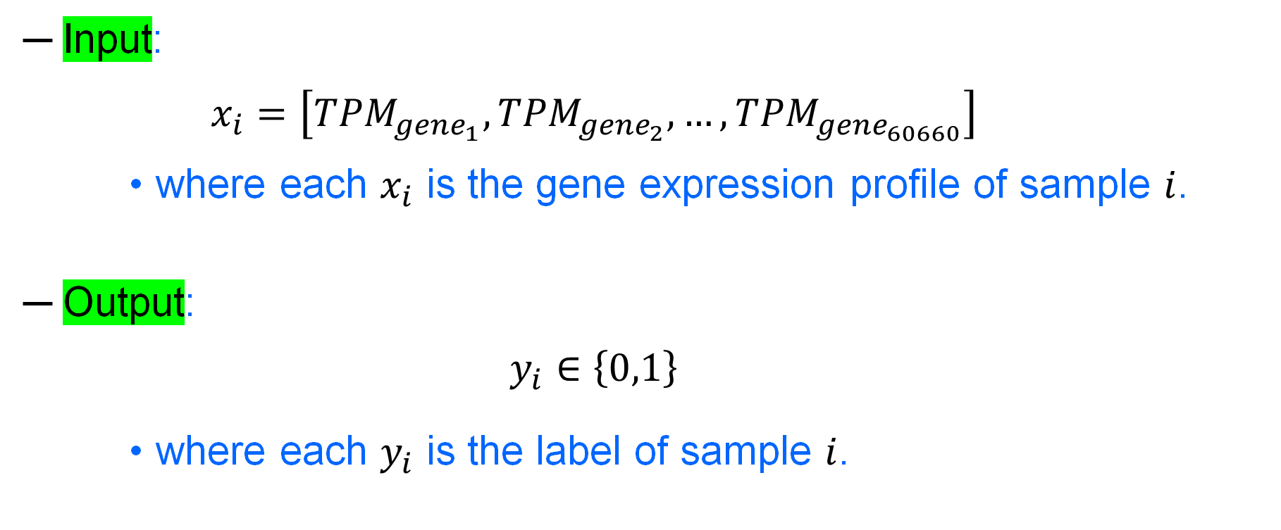
Problem Statement
Input:
$$x_{i}=\left[{TPM}_{{gene}_{1}},{TPM}_{{gene}_{2}},…,{TPM}_{{gene}_{60660}}\right]$$
where each $x_{i}$ is the gene expression profile of sample $i$.
Output:
$$y_{i}∈\left\{0,1\right\}$$
where each $y_{i}$ is the label of sample $i$.

Slide 26
Problem Statement
Input:
A feature vector representing the expression levels of 60,660 genes for each sample.
Clinical features
Output:
Task 3:
Risk Score: A specific number for each patient. The higher the score, the greater the risk of premature death.

Slide 27
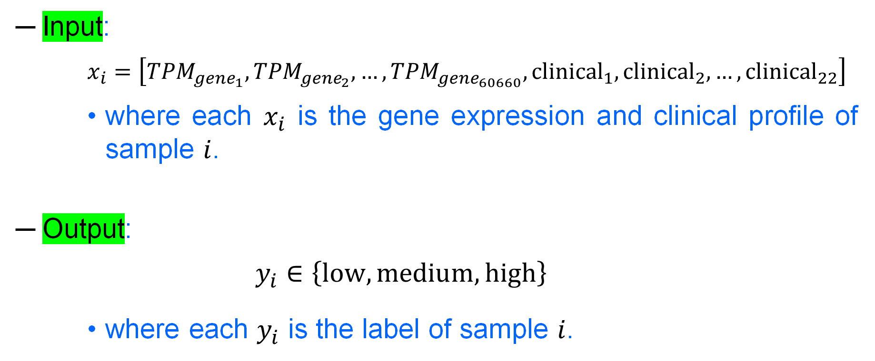
Problem Statement
Input:
$$x_{i}=\left[{TPM}_{{gene}_{1}},{TPM}_{{gene}_{2}},…,{TPM}_{{gene}_{60660}},{clinical}_{1},{clinical}_{2},…,{clinical}_{22}\right]$$
where each $x_{i}$ is the gene expression and clinical profile of sample $i$.
Output:
$$y_{i}∈\left\{low,medium, high\right\}$$
where each $y_{i}$ is the label of sample $i$.

Slide 28
Table of Content
Introduction & Problem Statement
Data Preparation
Exploratory Data Analysis
Data Preprocessing
Modeling & Results
Demo

Slide 29
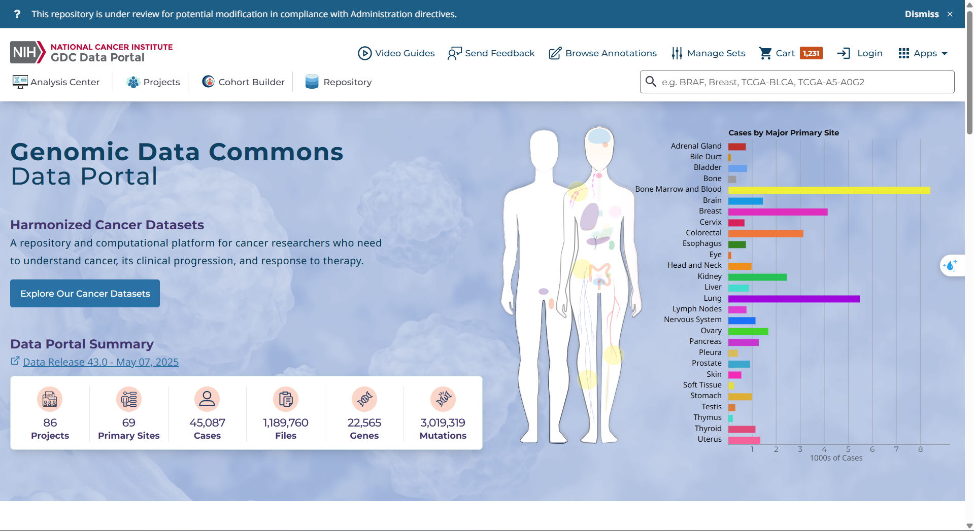
Data Preparation
Source: GDC Data Portal
Project: TCGA-BRCA (The Cancer Genome Atlas – Breast Invasive Carcinoma)

Slide 30
Data Preparation
Samples: 1,231 RNA-Seq samples (1,095 patients)

Slide 31
Data Preparation
Gene Expression Data – Preparation:
gdc_manifest.2025-10-21.083705.txt
Task 1 - Annotate Preparation:
clinical.cart.2025-10-21.json
Task 2, 3 - Annotate Prepapation
gdc_sample_sheet.2025-10-21.tsv

Slide 32
Data Preparation
Gene Expression Data – Preparation:
gdc_manifest.2025-10-21.083705.txt
Task 1 - Annotate Preparation:
clinical.cart.2025-10-21.json
Task 2, 3 - Annotate Prepapation
gdc_sample_sheet.2025-10-21.tsv

Slide 33
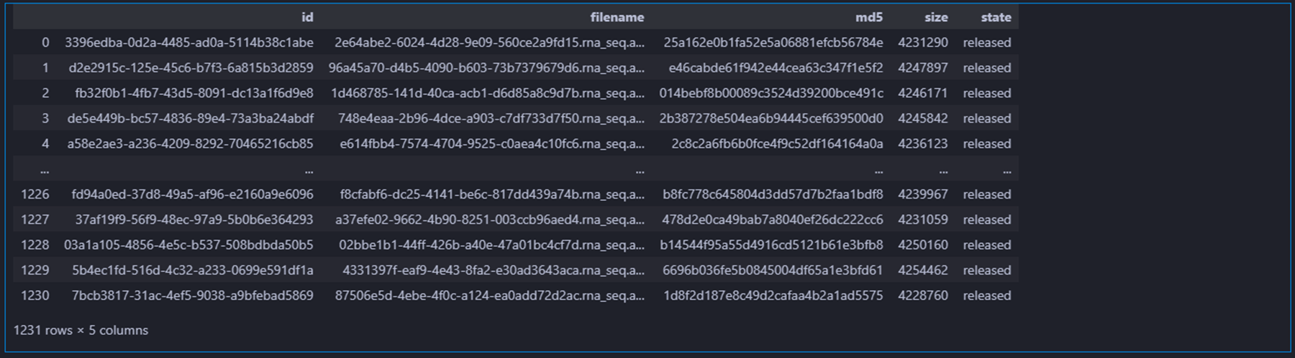
Data Preparation
gdc_manifest.2025-10-21.083705.txt

Slide 34
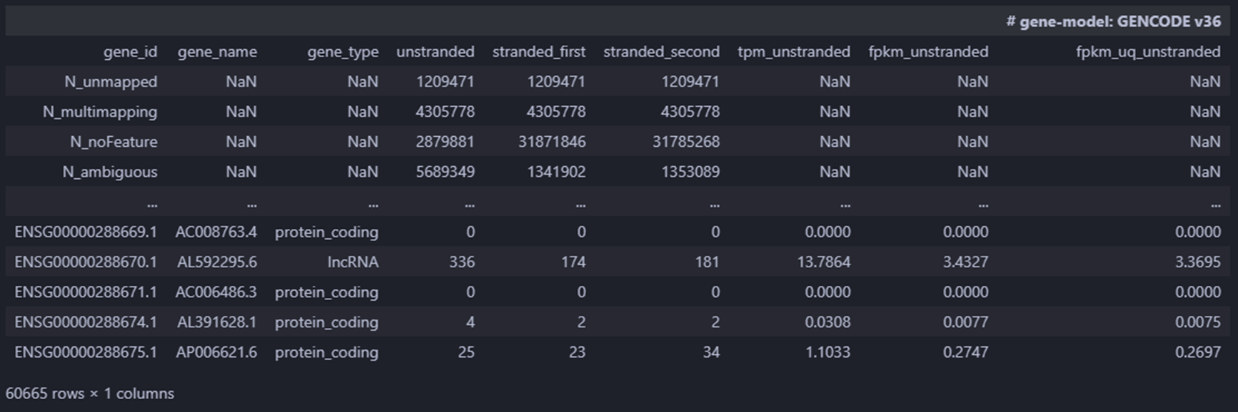
Data Preparation
c763a483-415e-4cb4-9cdf-4e6c31e8a9c9.rna_seq.augmented_star_gene_counts.tsv

Slide 35
Data Preparation
Gene Expression Data – Preparation:
gdc_manifest.2025-10-21.083705.txt
Task 1 - Annotate Preparation:
gdc_sample_sheet.2025-10-21.tsv
Task 2, 3 - Annotate Prepapation
clinical.cart.2025-10-21.json

Slide 36
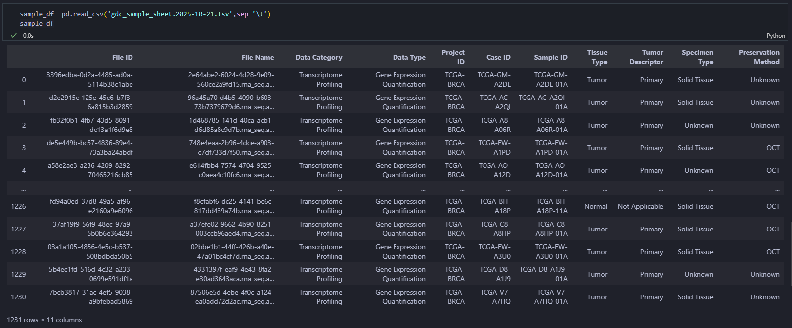
Data Preparation

Slide 37
Data Preparation
Gene Expression Data – Preparation:
gdc_manifest.2025-10-21.083705.txt
Task 1 - Annotate Preparation:
gdc_sample_sheet.2025-10-21.tsv
Task 2, 3 - Annotate Prepapation
clinical.cart.2025-10-21.json

Slide 38
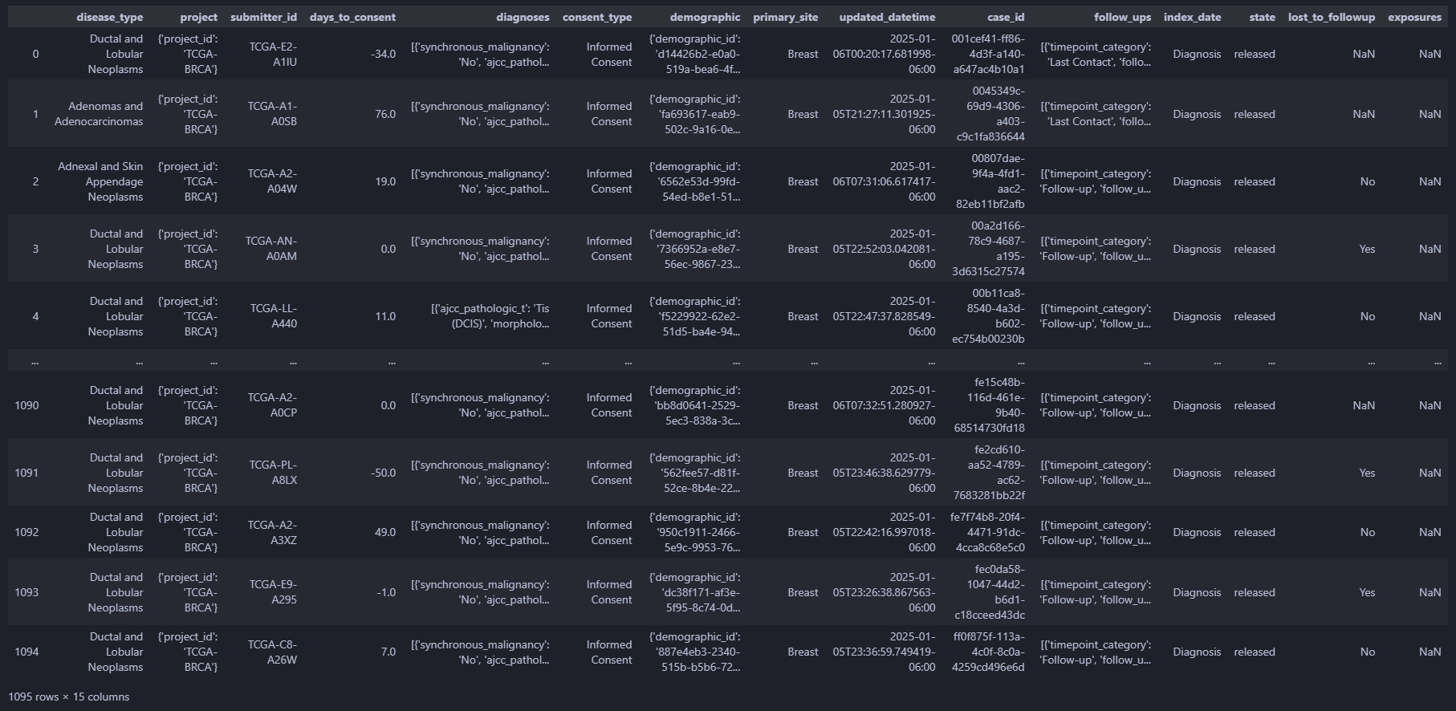
Data Preparation

Slide 39
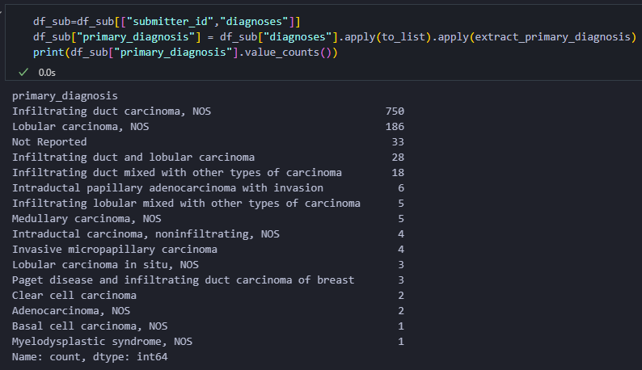
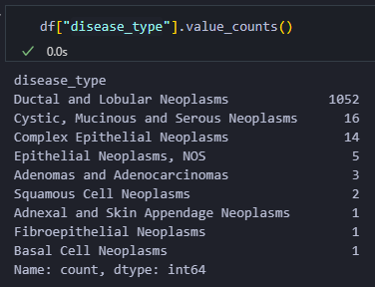
Data Preparation

Slide 40
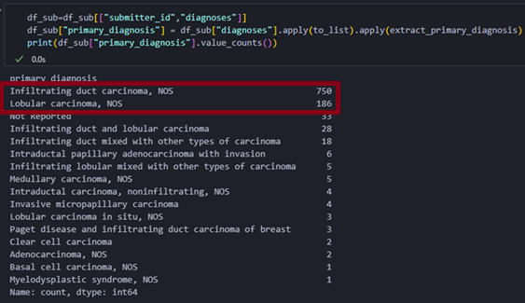
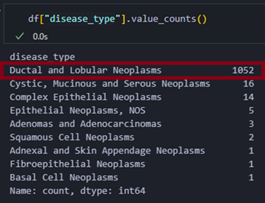
Data Preparation

Slide 41
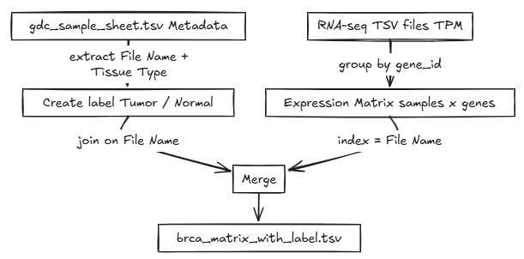
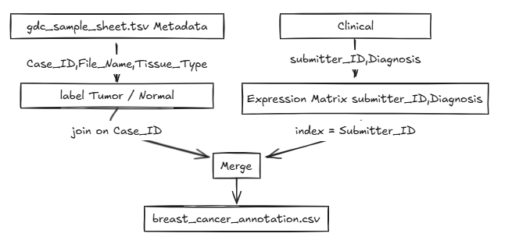
Data Preparation

Slide 42
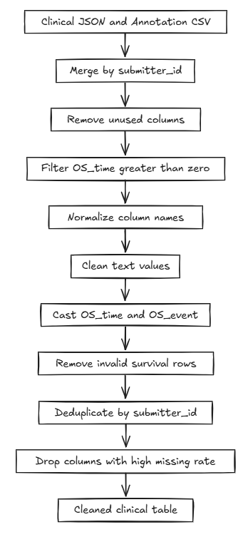
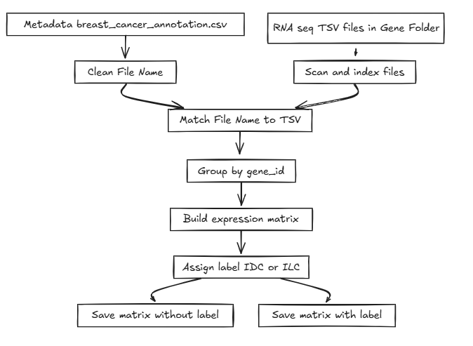
Data Preparation

Slide 43
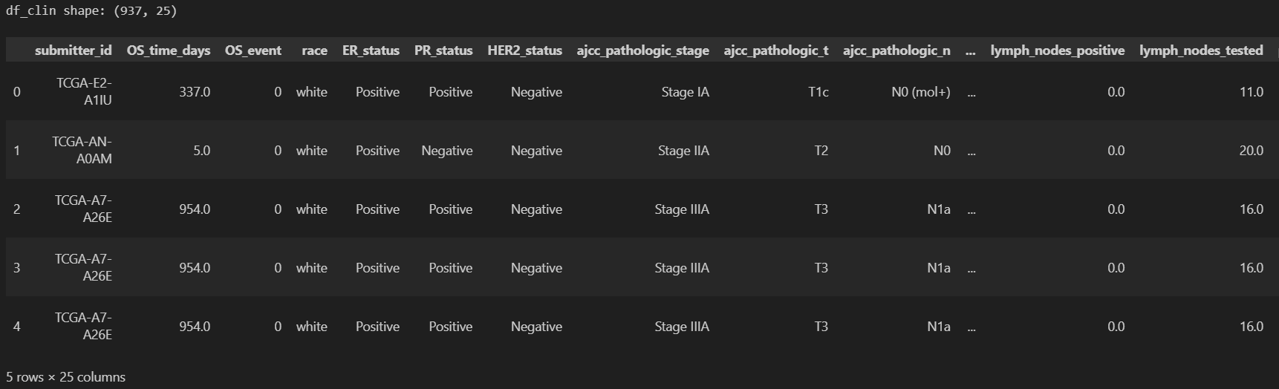
Data Preparation
Time_col,event_col="OS_time_days","OS_event"
Cat_cols=["race","ER_status","PR_status","HER2_status","ajcc_pathologic_stage","ajcc_pathologic_t","ajcc_pathologic_n","ajcc_pathologic_m","laterality","morphology","method_of_diagnosis","menopause_status","primary_diagnosis_y"]
Num_cols=["age_at_diagnosis_years","lymph_nodes_positive","lymph_nodes_tested","positive_ratio"]
Bin_cols=["tx_surgery_any","tx_radiation_any","tx_chemo_any","tx_hormone_any"]

Slide 44
Table of Content
Introduction & Problem Statement
Data Preparation
Exploratory Data Analysis
Data Preprocessing
Modeling & Results
Demo

Slide 45
General information

Slide 46
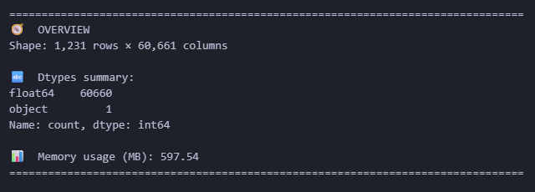
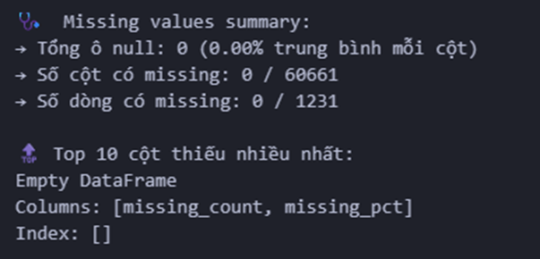
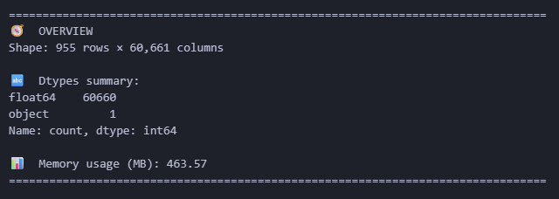
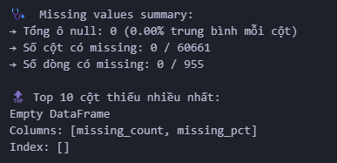
Exploratory Data Analysis

Slide 47
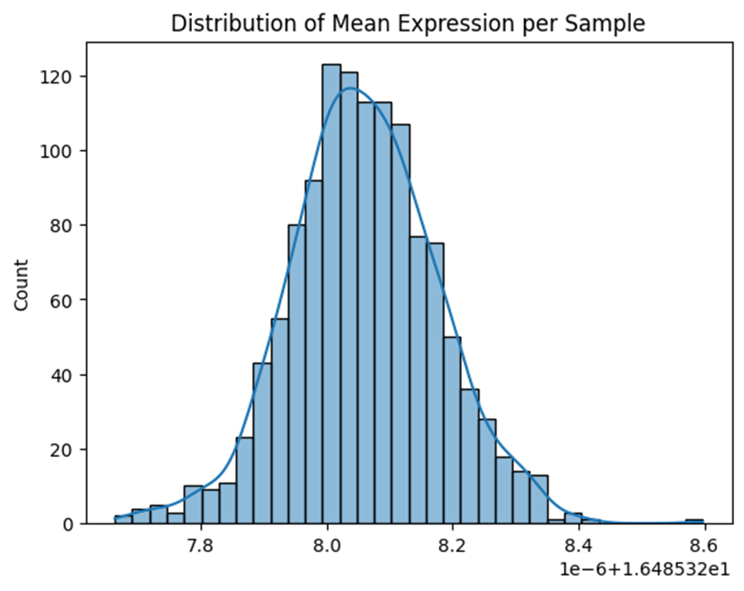
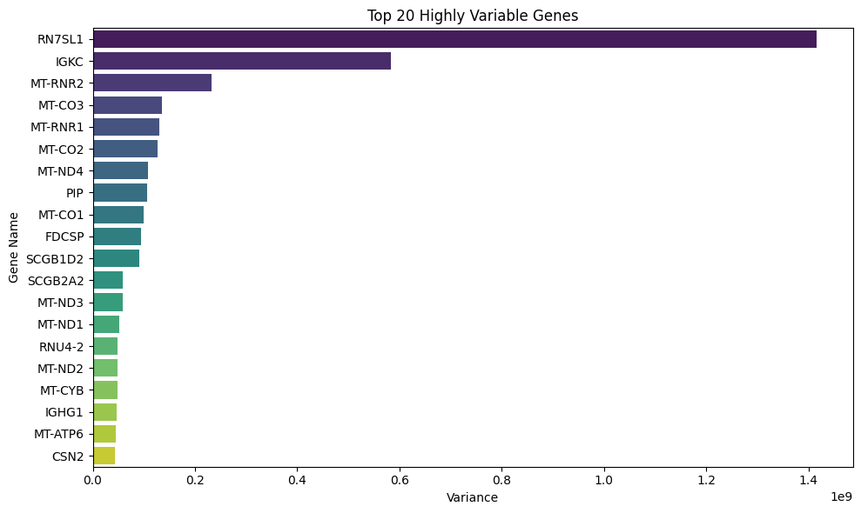
Exploratory Data Analysis

Slide 48
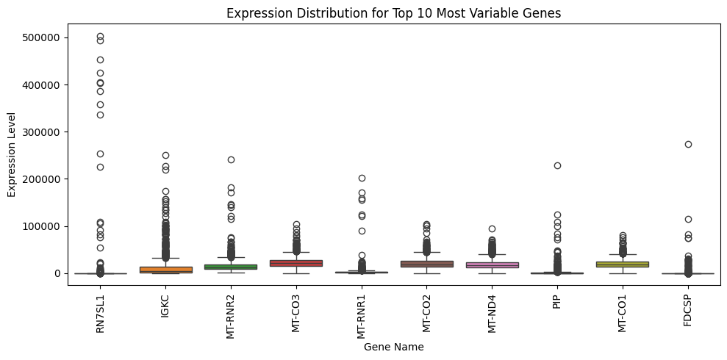
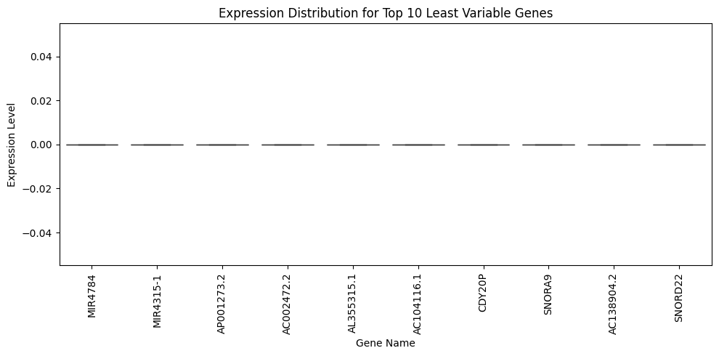
Exploratory Data Analysis

Slide 49
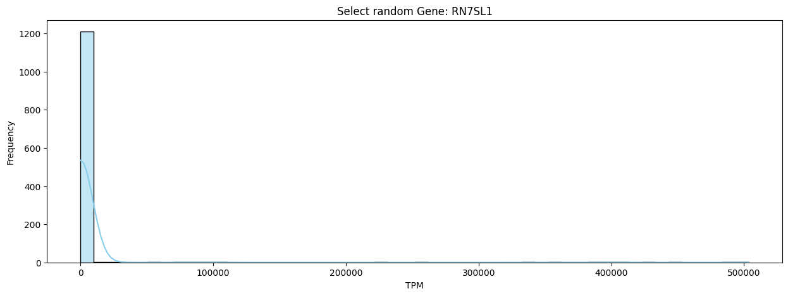
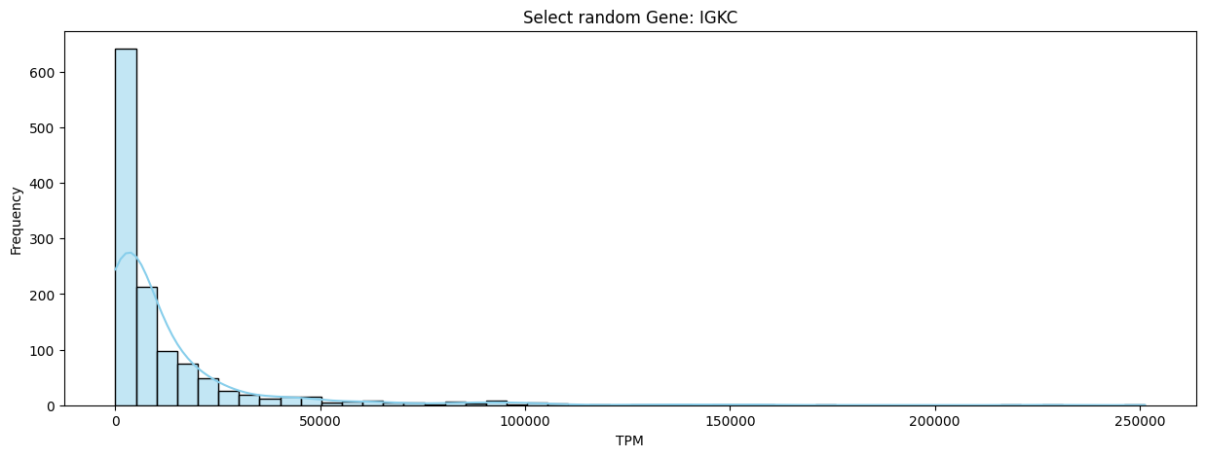
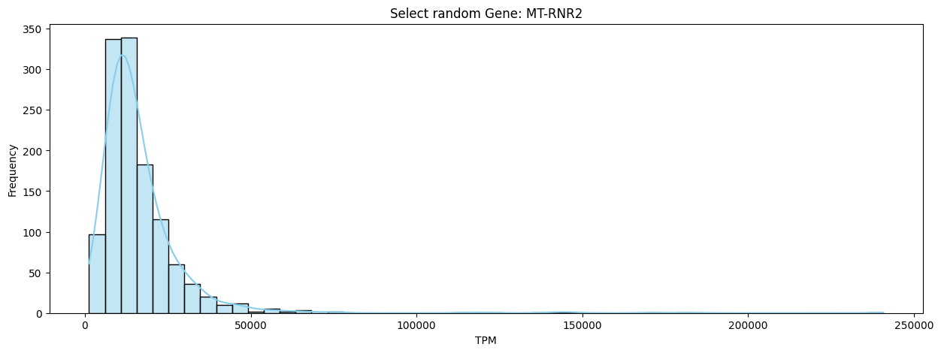
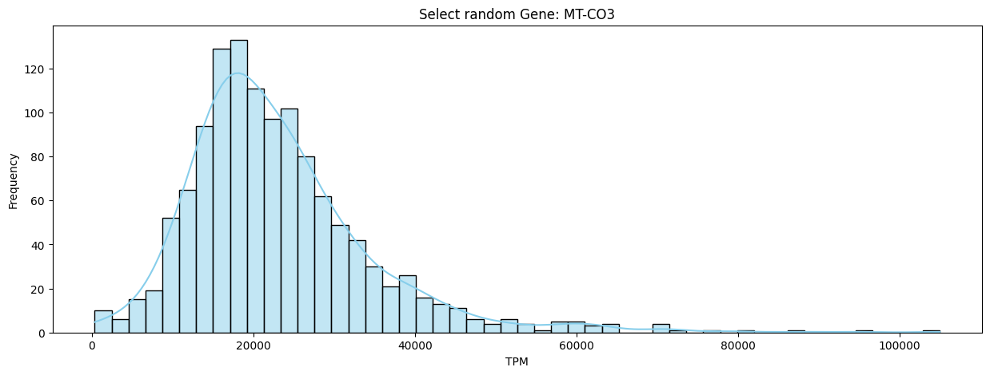
Exploratory Data Analysis

Slide 50
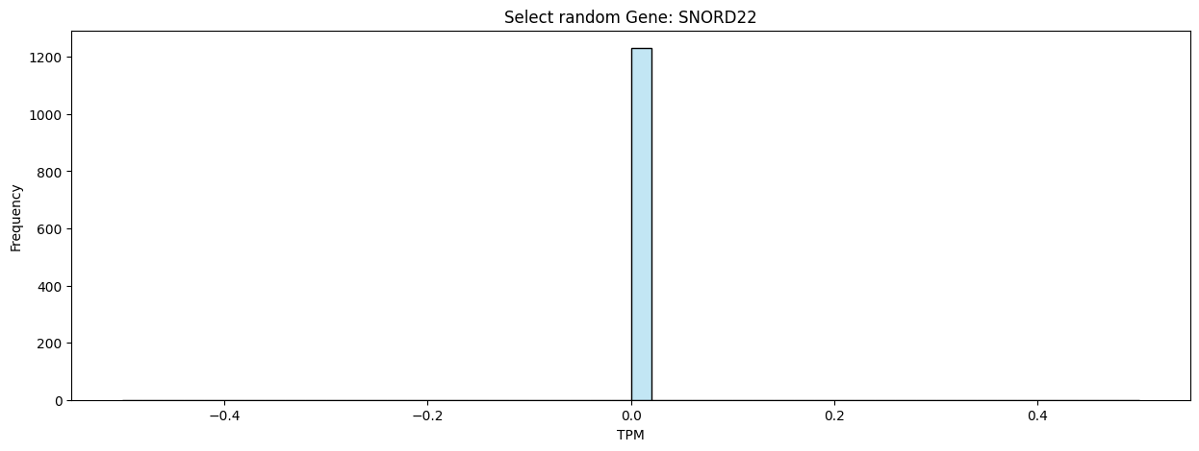


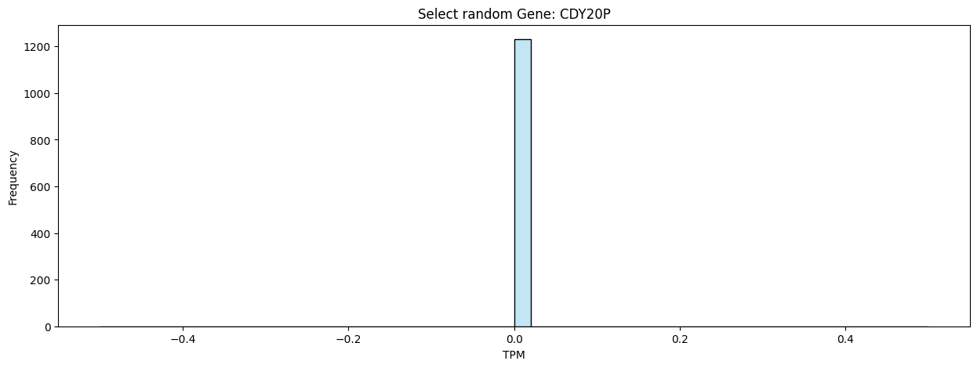
Exploratory Data Analysis

Slide 51
Task 1: Normal vs Tumor

Slide 52
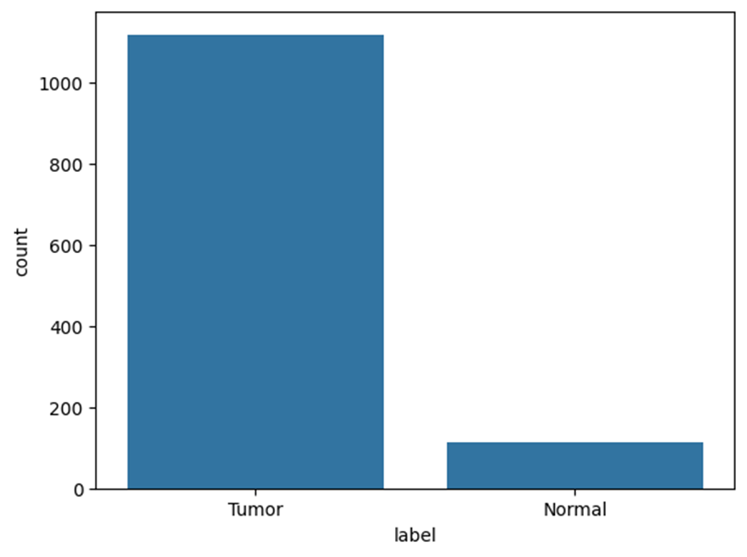
Exploratory Data Analysis
Tumor: 1,118 samples
Normal: 113 samples

Slide 53
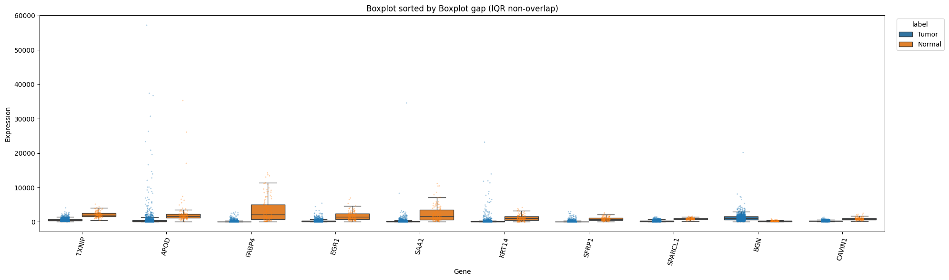
Exploratory Data Analysis

Slide 54
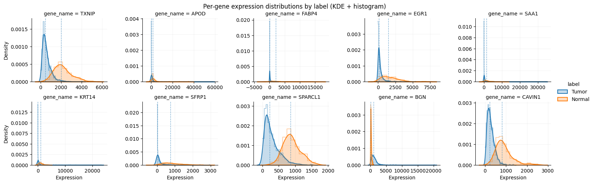
Exploratory Data Analysis

Slide 55
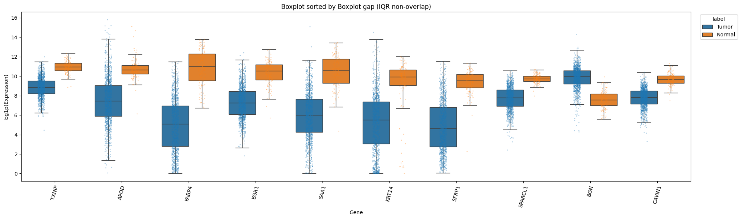
Exploratory Data Analysis

Slide 56
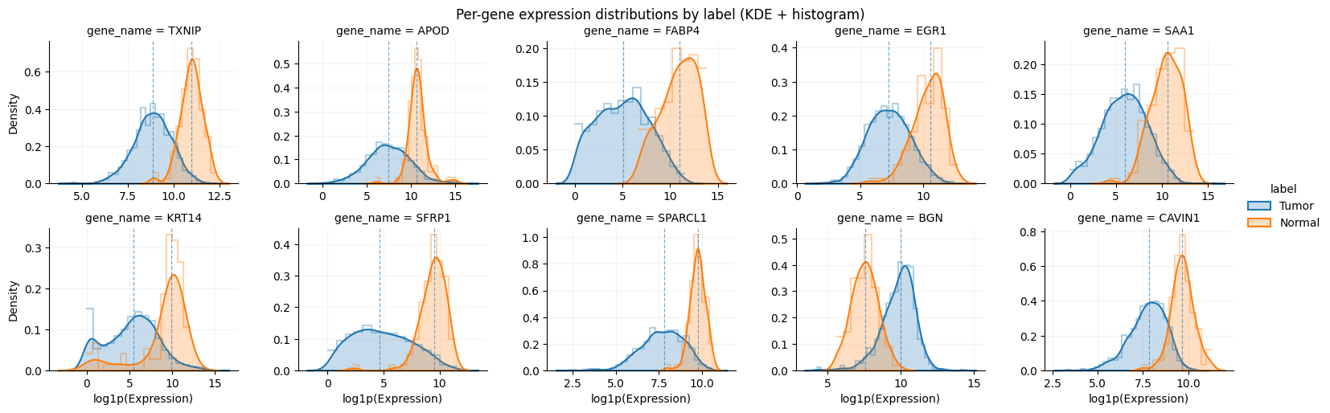
Exploratory Data Analysis

Slide 57
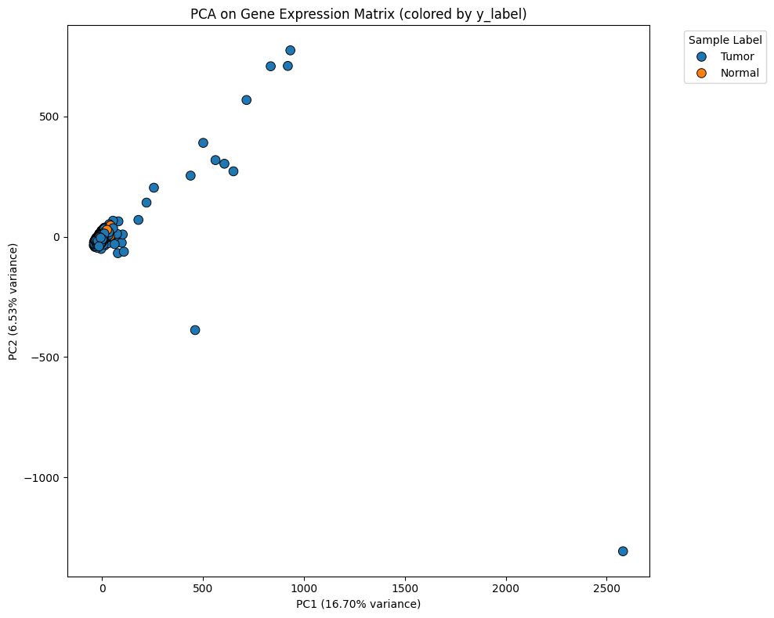
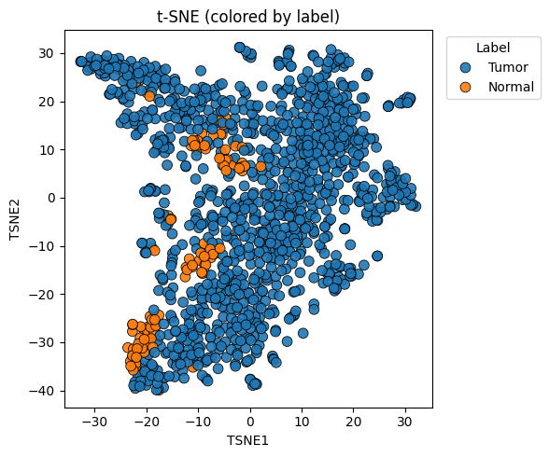
Exploratory Data Analysis

Slide 58
Task 2: IDC vs ILC

Slide 59
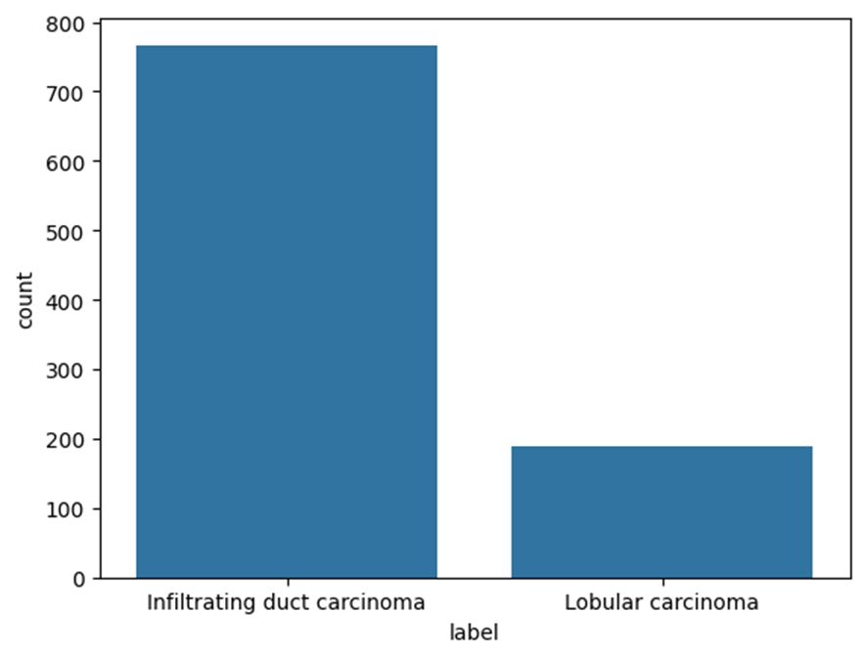
Exploratory Data Analysis
IDC: 767 samples
ILC: 188 samples

Slide 60
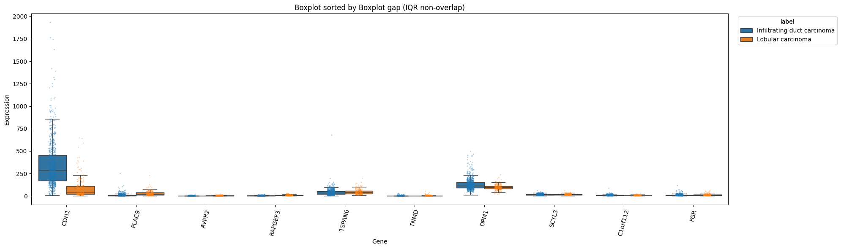
Exploratory Data Analysis

Slide 61
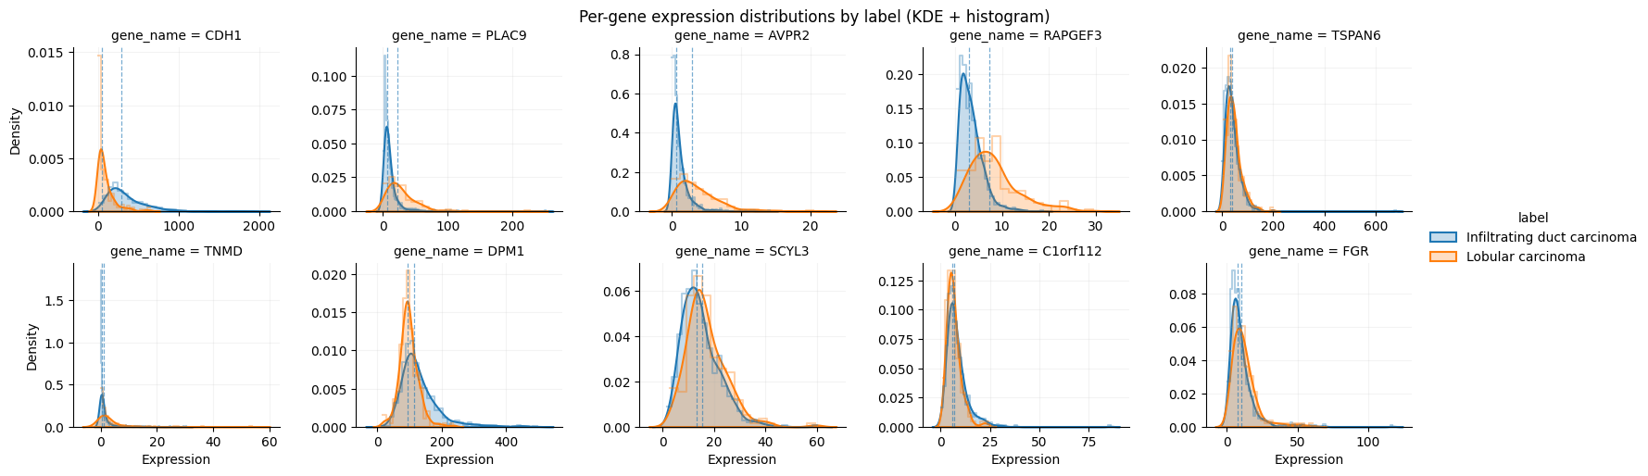
Exploratory Data Analysis

Slide 62
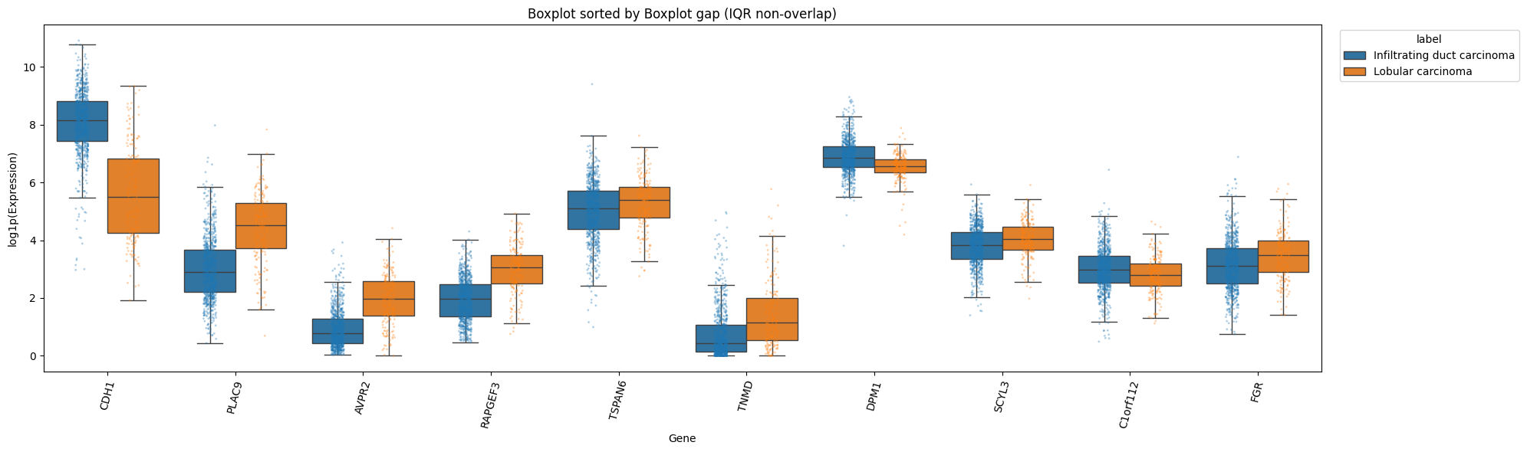
Exploratory Data Analysis

Slide 63
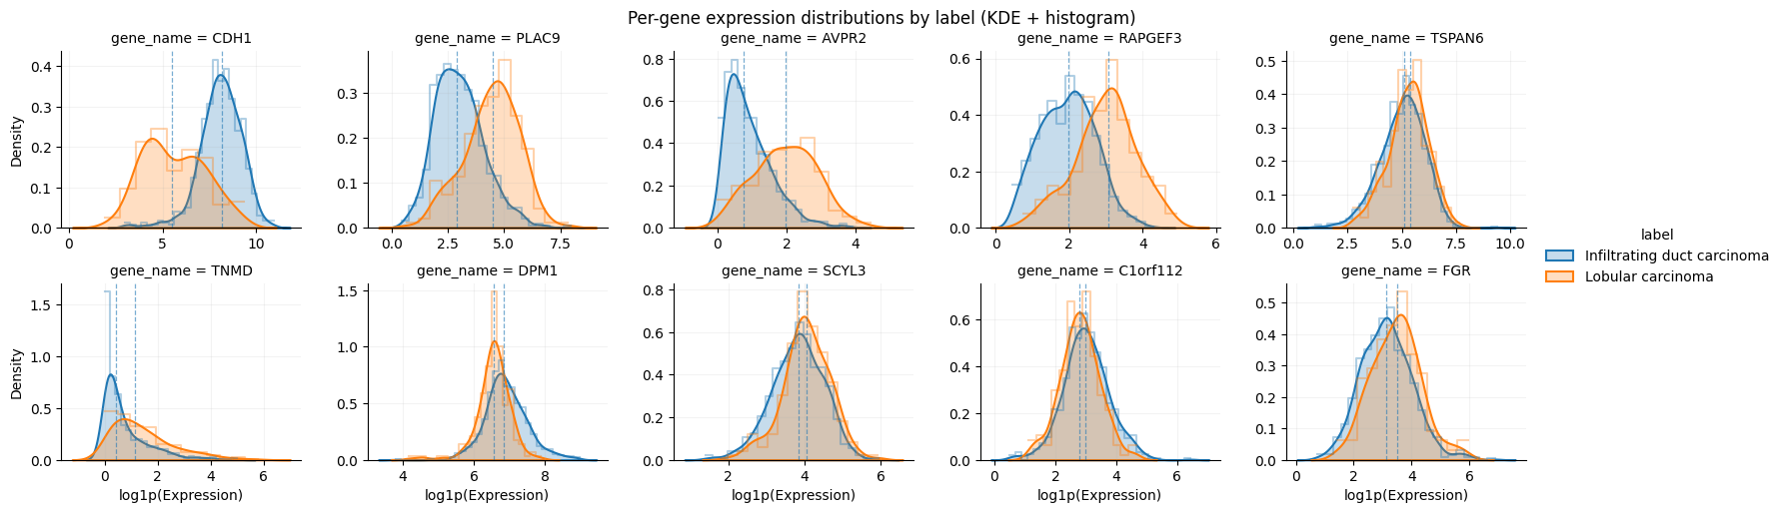
Exploratory Data Analysis

Slide 64
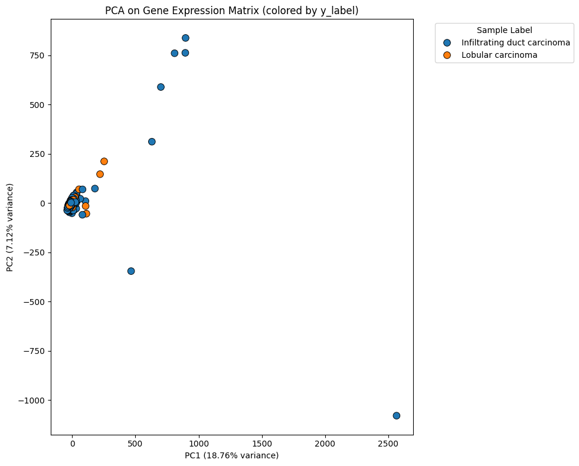
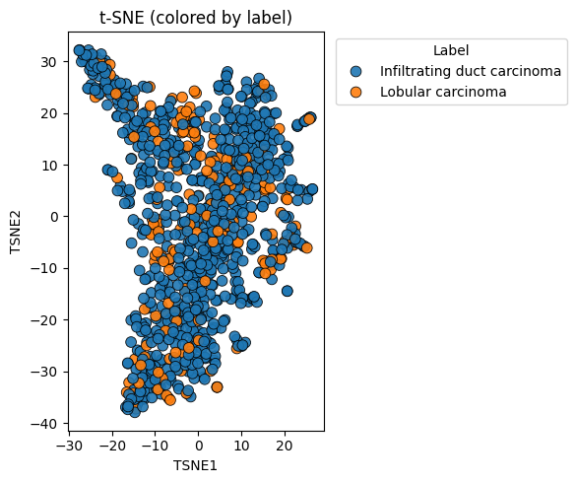
Exploratory Data Analysis

Slide 65
Task 3: Survival analysis

Slide 66
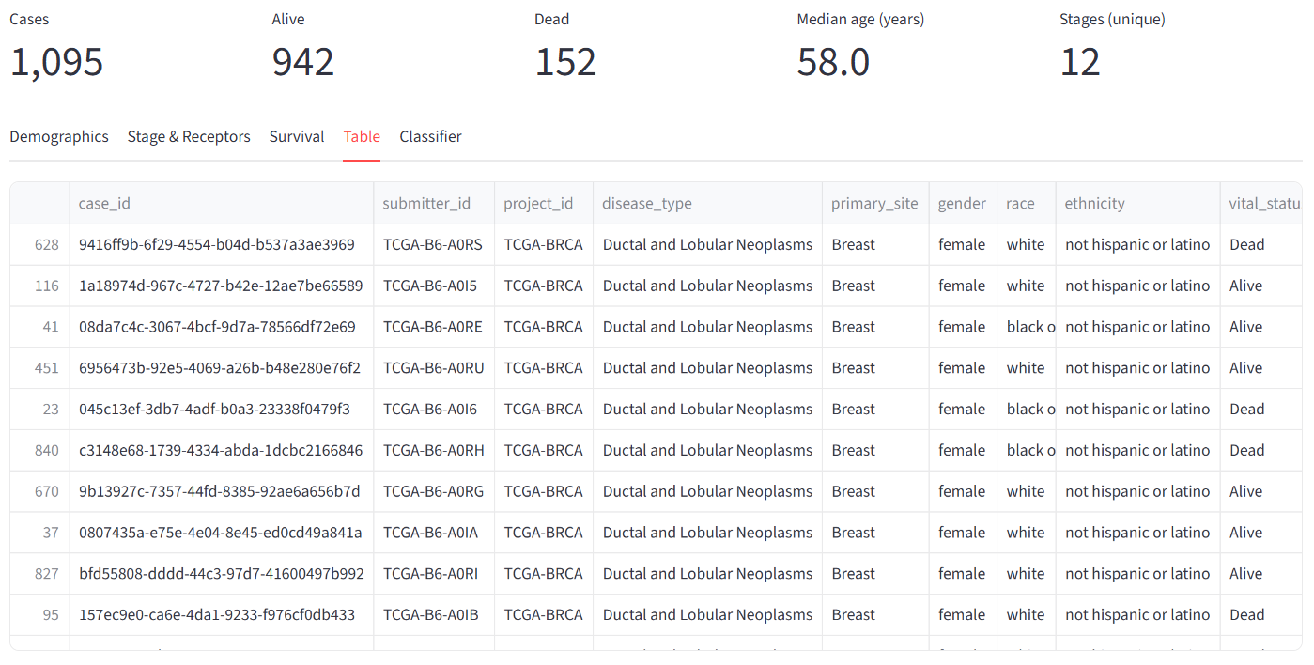
Exploratory Data Analysis

Slide 67
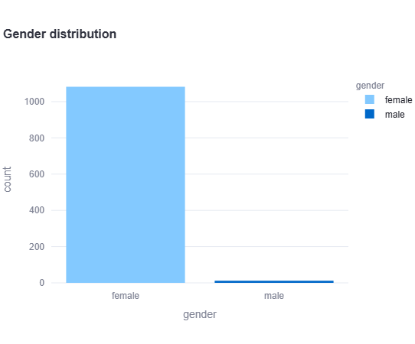
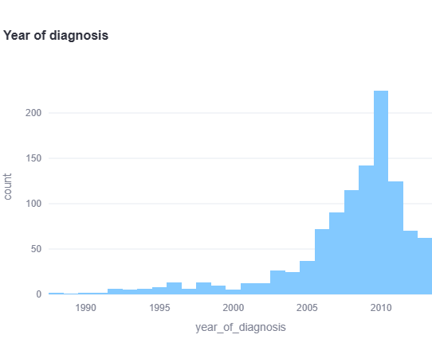
Exploratory Data Analysis

Slide 68
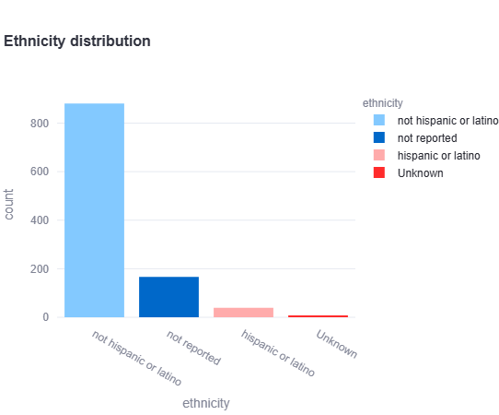

Exploratory Data Analysis

Slide 69


Exploratory Data Analysis

Slide 70


Exploratory Data Analysis

Slide 71




Exploratory Data Analysis

Slide 72




Exploratory Data Analysis

Slide 73




Exploratory Data Analysis

Slide 74
Table of Content
Introduction & Problem Statement
Data Preparation
Exploratory Data Analysis
Data Preprocessing
Modeling & Results
Demo

Slide 75


Slide 76
Task 1: Normal vs Tumor

Slide 77


Data preprocessing
($\log_{2}\left(x+1\right) \text{Transform})$
Reason: To stabilize variance, "compress" large outlier values, and normalize heavily skewed data.

Slide 78

Data preprocessing
Filter VarianceThreshold(0.0)
Reason: To remove "useless" genes (features with the same value across all samples).

Slide 79

Data preprocessing
Scaling with MaxAbsScaler
Reason: To scale all genes to the same [0, 1] range. It preserves the meaning of the number 0.

Slide 80

Data preprocessing
Filter with SelectKBest & f_classif
Reason: To select the k best genes (e.g., 100) with the strongest statistical relationship to the label (Tumor/Normal).

Slide 81


Data preprocessing
Correlation Filter
Reason: To remove redundant genes (e.g., > 0.95 correlation) to keep a final, "essential" set of independent features.

Slide 82
Task 2: IDC vs ILC

Slide 83



Data preprocessing

Slide 84



Data preprocessing

Slide 85
Task 3: Survival analysis

Slide 86


Slide 87


Data preprocessing

Slide 88




Data preprocessing

Slide 89




Data preprocessing

Slide 90




Data preprocessing

Slide 91




Data preprocessing

Slide 92




Data preprocessing

Slide 93

Data preprocessing
Filter with SelectKBest & cindex_survival_score
Reason: An optimal method to reduce noise and prevent overfitting in genomic data, selecting features that effectively handle censoring and accurately rank patient survival risks.

Slide 94
Table of Content
Introduction & Problem Statement
Data Preparation
Exploratory Data Analysis
Data Preprocessing
Modeling & Results
Demo

Slide 95
modeling

Slide 96
Methods
Strategy: 80/20 Hold-out split combined with GridSearchCV (5-fold nested CV) for hyperparameter tuning.
Splitter: StratifiedGroupKFold used for both outer and inner loops to:
Ensure samples from the same patient (group) do not leak.
Maintain class balance (stratified) across folds.
Metric: Optimized for average_precision (PR-AUC) due to imbalanced data.

Slide 97
Methods
Strategy: 80/20 Hold-out split combined with GridSearchCV (5-fold nested CV) for hyperparameter tuning.
Splitter: StratifiedGroupKFold used for both outer and inner loops to:
Ensure samples from the same patient (group) do not leak.
Maintain class balance (stratified) across folds.
Metric: Optimized for average_precision (PR-AUC) due to imbalanced data.

Slide 98
Hyperparameter Tuning Grid
Common Tuned Parameter (All Models):
pipeline__kbest__k (Number of Genes): [50, 100, 500, 1000, 2000, 3000, 4000]
Logistic Regression (L2)
Fixed: class_weight="balanced" (Handles imbalance)
Tuned: C (Regularization): [0.1, 1, 3]
SVM
Fixed: class_weight="balanced" (Handles imbalance)
Tuned: C (Regularization): [0.1, 1, 3]

Slide 99
Hyperparameter Tuning Grid
Random Forest
Fixed: class_weight="balanced_subsample"
Tuned:
n_estimators (Trees): [300, 600, 1000]
max_depth: [None, 10, 20, 50]

Slide 100
Hyperparameter Tuning Grid
XGBoost
Fixed: scale_pos_weight=spw (Handles imbalance)
Tuned:
n_estimators: [600, 1000]
max_depth: [4, 6]
learning_rate: [0.05, 0.03]

Slide 101
Hyperparameter Tuning Grid
CoxPH
Fixed: L1_RATIO = 0.0
Tuned:
K_list: [10, 50, 100, 300, 500, 600]

Slide 102
Hyperparameter Tuning Grid
Coxnet
Fixed:
L1_RATIO = 0.5
N_ALPHAS = 100
Tuned:
K_list: [10, 50, 100, 300, 500, 600]

Slide 103
Hyperparameter Tuning Grid
CoxPHFilter
Fixed: penalizer = 0.1
Tuned:
SelectKBest: [10,50,100,300,500]

Slide 104
Hyperparameter Tuning Grid
CoxnetSurvivalAnalysis
Fixed: n_alphas = 100, alpha_min_ratio= 0.1
Tuned:
SelectKBest: [10,50,100,300,500]

Slide 105
results

Slide 106
Task 1: Normal vs Tumor

Slide 107
Results CV(inner)
 | Best PR-AUC | SelectKBest
Logistic Regression | 1.0 | 1030
SVM | 0.9999 | 100
Random Forest | 1.0 | 1000
XGBoost | 1.0 | 1030

Slide 108
Results
 | ROC-AUC | PR-AUC | F1 | ACC
Logistic Regression | 1.0 | 1.0 | 0.9978 | 0.9959
SVM | 1.0 | 1.0 | 0.9956 | 0.9918
Random Forest | 1.0 | 1.0 | 0.9978 | 0.9959
XGBoost | 1.0 | 1.0 | 0.9978 | 0.9959

Slide 109



Results
Logistic Regression
SVM
Random Forest
XGBoost

Slide 110
Task 2: IDC vs ILC

Slide 111
Results CV(inner)
 | Best PR-AUC | SelectKBest
Logistic Regression | 0.9826 | 100
SVM | 0.9828 | 100
Random Forest | 0.9796 | 100
XGBoost | 0.9851 | 2000

Slide 112
Results
 | ROC-AUC | PR-AUC | F1 | ACC
Logistic Regression | 0.9339 | 0.9826 | 0.9184 | 0.8730
SVM | 0.9332 | 0.9825 | 0.9220 | 0.8783
Random Forest | 0.9227 | 0.9758 | 0.9560 | 0.9259
XGBoost | 0.9470 | 0.9858 | 0.9515 | 0.9206

Slide 113




Results
Logistic Regression
SVM
Random Forest
XGBoost

Slide 114
Task 3: Survival analysis

Slide 115


Slide 116
Results
 | C_index Test
CoxPH | 0.7886
CoxNet | 0.7697

Slide 117


Results
CoxPH
CoxnetSurvivalAnalysis

Slide 118


Results
CoxPH
CoxnetSurvivalAnalysis

Slide 119
Table of Content
Introduction & Problem Statement
Data Preparation
Exploratory Data Analysis
Data Preprocessing
Modeling & Results
Demo

Slide 120
Thank you for your attention University of Information Technology – HCMC

